Slide 1
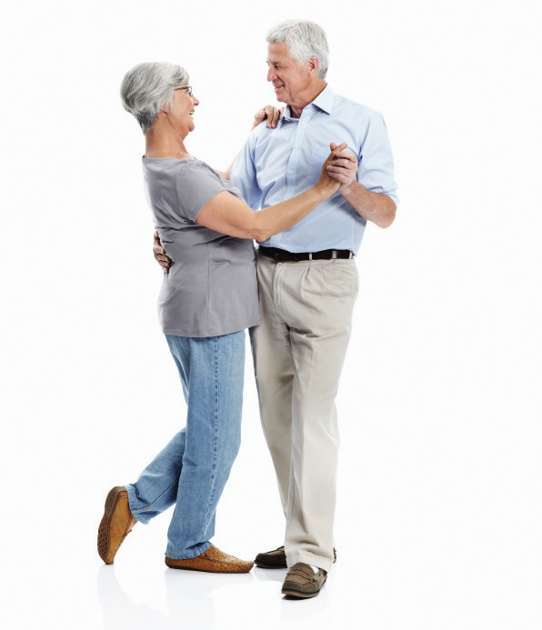
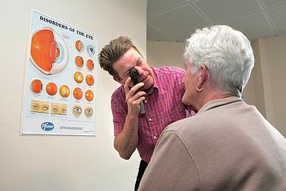


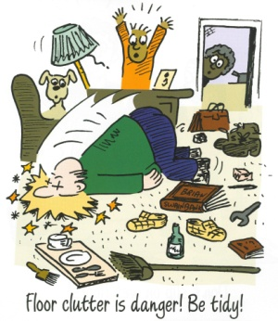
Positive Steps to Avoid Slips, Trips and Falls
Falls are the most serious type of accidents in the over 65’s. There are many things which can cause us to fall like feeling dizzy, having difficulty walking or rising from a chair, poor balance, poor eyesight and hearing, medications, clutter, poor lighting. The good news is:
Many falls can be prevented
Take action now to help prevent a fall
Stay Active
Exercise as much as you can. Walking can help improve mobility, strength, balance and flexibility.
Vision and Hearing
Have yearly eyesight test
Keep glasses clean
Wear correct glasses
Avoid bifocals/varifocals
Poor hearing can affect balance–speak to your GP if you are concerned.
Eat Well and Drink Plenty Fluids
Eat regularly
Eat foods rich in calcium and Vit D for your bones
Drink 6–8 glasses fluid/day
Avoid alcohol
Keep Feet Healthy
Wear well fitting low heeled shoes with fastener
Avoid slippers, peep toes sling backs
Look after your feet.
Consider Podiatry
Look After Your Health
Report all falls
Let your GP know if you have dizziness, light headedness, or blackouts
Have your medication checked regularly
Environment
Keep a night light at bed
Do not stand on chairs
Remove rugs. Fix carpet
Secure flexes. Use handrail
?
What if you do fall?
By pressing your community alarm/pulling your cord you will be connected to help
immediately so always wear it. Report any fall you have to your warden or GP. There is a falls service which you might benefit from which they can refer you to if required.
Always report any falls you have
Angus Falls Service
01356 665170

